Slide 1
Chapter 3 Discrete Random Variable
Random Variables
Probability Distributions for Discrete Random Variables
Expected Values of Discrete Random Variables
The Binomial Probability Distribution
Hypergeometric and Negative Binomial Distributions
The Poisson Probability Distribution

Slide 2
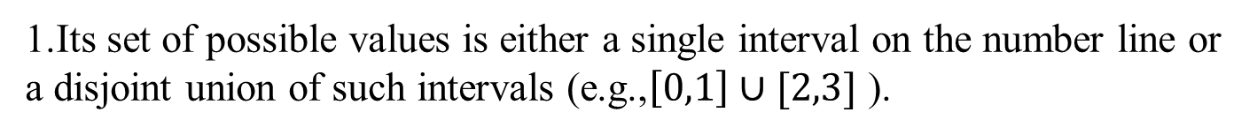
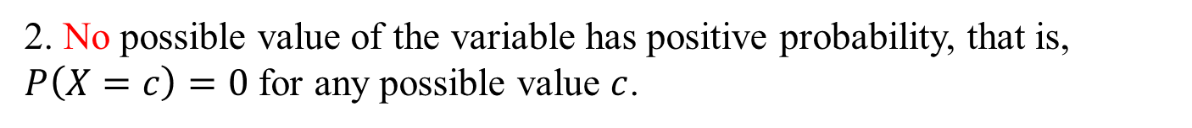
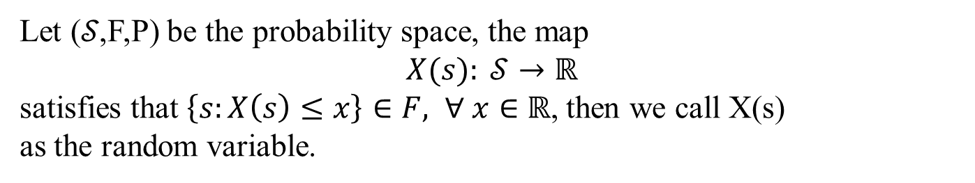

3.1 Random variable
For a given sample space of some experiment, a random variable (rv) is any rule that associates a number with each outcome in $𝒮$.
Let (𝒮,F,P) be the probability space, the map
$$X(s): 𝒮→ℝ$$
satisfies that $\left\{s:X\left(s\right)≤x\right\}∈F, ∀ x∈$ $ℝ$, then we call X(s)
as the random variable.
Two types of random variables
If the possible values of a random variable either constitute a finite set or else can be listed in an infinite sequence one-to-one (“countably” infinite ), it is called discrete random variable.
While a random variable is continuous if both of the following apply:
1.Its set of possible values is either a single interval on the number line or a disjoint union of such intervals (e.g.,$\left[0,1\right]∪[2,3]$ ).
2. No possible value of the variable has positive probability, that is,
$P\left(X=c\right)=0$ for any possible value $c$.

Slide 3
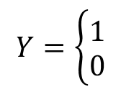
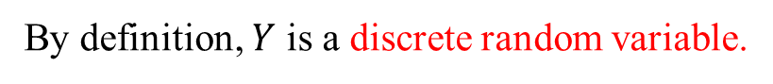
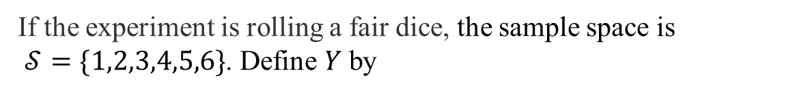
Example
If the experiment is rolling a fair dice, the sample space is
$𝒮=\{1,2,3,4,5,6\}$. Define $Y$ by
$$Y=\left\{\begin{aligned}1 \\ 0\end{aligned}\right.$$
if an even number appears
if an odd number appears
$Y$is a Bernoulli random variable whose possible values are $0$ and $1$.
By definition, $Y$ is a discrete random variable.
Example
If the experiment is repeatedly tossing a coin until the first tail shows up.
The sample space is $𝒮=\{T, HT, HHT,HHHT,…,HHH…\}$. Define $X$by
$X=$ the number of tossing needed in order to get the first tail.
The possible values of $X$can be listed in an infinite sequence one-to-one (“countably” infinite), and thus $X$ is a discrete random variable.
Example
If we randomly select a real number from the single interval $[A, B]$ and let $H=$ the number selected, $H$ is a continuous rv.

Slide 4
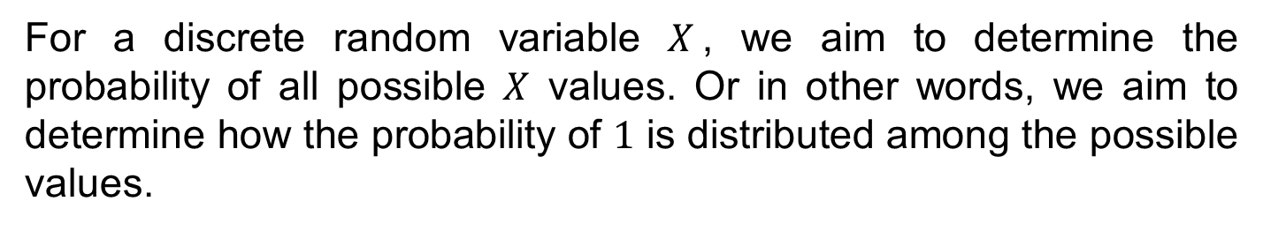
3.2 Probability Distributions for Discrete Random Variables
For a discrete random variable $X$, we aim to determine the probability of all possible $X$ values. Or in other words, we aim to determine how the probability of $1$ is distributed among the possible values.
This is actually what the probability distribution of a discrete rv tells us.

Slide 5

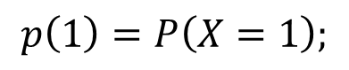
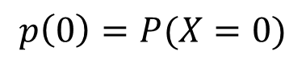
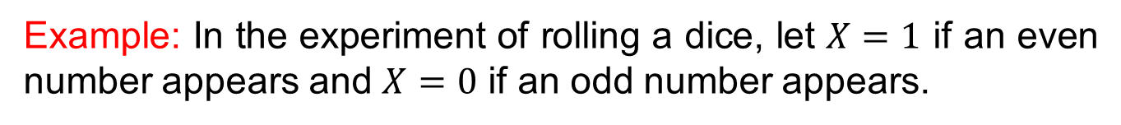
Example: In the experiment of rolling a dice, let $X=1$ if an even number appears and $X=0$ if an odd number appears.
Possible $X$values are then $0$ and $1$. The probability distribution
will tell us how the probability of $1$ is distributed among these two possible values.
We will use the following notation:
$$p\left(1\right)=P\left(X=1\right);$$
$$p\left(0\right)=P(X=0)$$
In general, $p(x)$will denote the probability assigned to the value $x$.

Slide 6
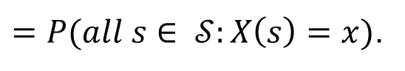
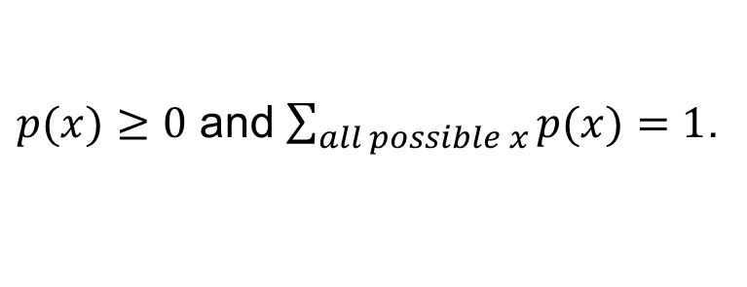
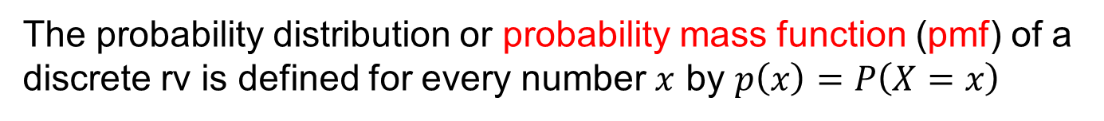
Definition
The probability distribution or probability mass function (pmf) of a discrete rv is defined for every number $x$ by $p\left(x\right)=P\left(X=x\right)$
$=P(all s∈ 𝒮:X\left(s\right)=x)$.
Remark:
Pmf of a discrete rv must satisfies:
$p(x)≥0$ and $\sum_{all possible x}^{ }{p(x)}=1$.
Pmf of a discrete rv indicates the probability of all possible values. And we can use it to calculate other probabilities of interest.

Slide 7
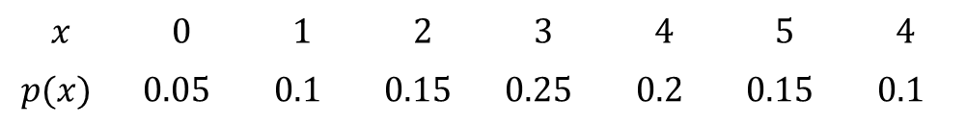
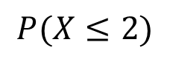
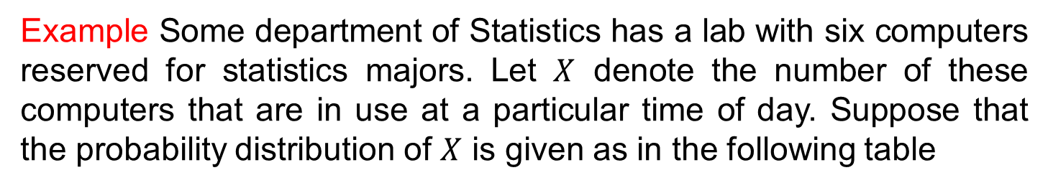
Example Some department of Statistics has a lab with six computers reserved for statistics majors. Let $X$ denote the number of these computers that are in use at a particular time of day. Suppose that the probability distribution of $X$ is given as in the following table
$$x$$ | $$0$$ | $$1$$ | $$2$$ | $$3$$ | $$4$$ | $$5$$ | $$4$$
$$p(x)$$ | $$0.05$$ | $$0.1$$ | $$0.15$$ | $$0.25$$ | $$0.2$$ | $$0.15$$ | $$0.1$$
1. What is the probability that at most $2$ computers are in use?
$$P(X≤2)$$
$=p\left(0\right)+p\left(1\right)+p\left(2\right)=0.05+0.1+0.15=0.3$.
2. What is the probability that at least $3$ computers are in use?
$$P\left(X≥3\right)=1−P\left(X≤2\right)=1−0.3=0.7$$

Slide 8
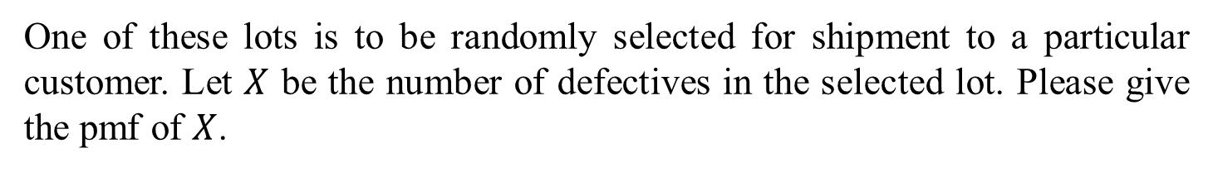
We now consider several examples to show how the pmf of rv can be obtained.
Example
Six lots of components are ready to be shipped by a certain supplier. The number of defective components in each lot is as follows:
lot | 1 | 2 | 3 | 4 | 5 | 6
No. of defective | 0 | 2 | 0 | 1 | 2 | 0
One of these lots is to be randomly selected for shipment to a particular customer. Let $X$ be the number of defectives in the selected lot. Please give the pmf of $X$.

Slide 9
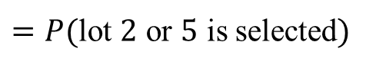
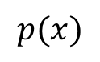
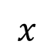
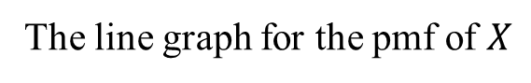
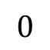
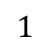
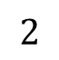
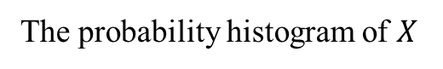
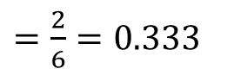
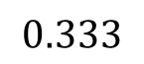
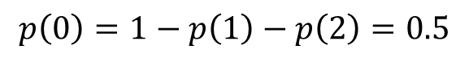
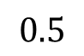
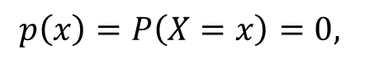
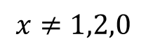
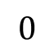

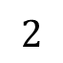
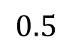
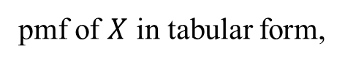
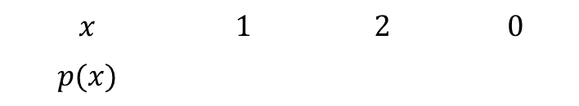
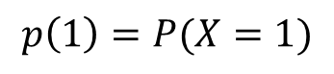
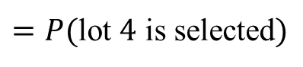
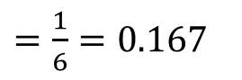
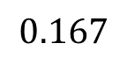
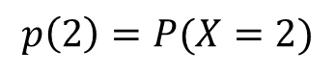
pmf of $X$ in tabular form,
$$x$$ | $$1$$ | $$2$$ | $$0$$
$$p(x)$$
$$0.167$$
$$0.333$$
$$0.5$$
$$p\left(1\right)=P(X=1)$$
$=P($lot $4$ is selected$)$
$=\frac{1}{6}=0.167$
$$p\left(2\right)=P(X=2)$$
$=P($lot $2$ or $5$ is selected$)$
$=\frac{2}{6}=0.333$
$$p\left(0\right)=1−p\left(1\right)−p\left(2\right)=0.5$$
$$p\left(x\right)=P\left(X=x\right)=0,$$
$$x≠1,2,0$$
The line graph for the pmf of $X$
The probability histogram of $X$
$$p(x)$$
$$0.5$$
$$0$$
$$1$$
$$2$$
$$x$$
$$0$$
$$1$$
$$2$$

Slide 10
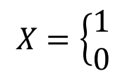
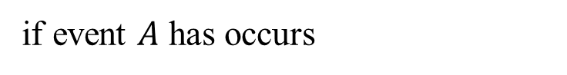
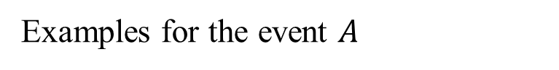
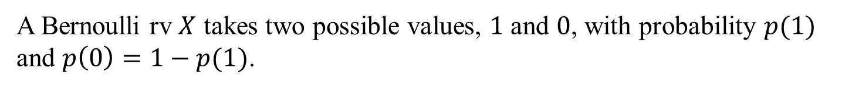
Some family of distributions
Bernoulli distributions (两点分布或者0-1分布)
A Bernoulli rv $X$ takes two possible values, $1$ and $0$, with probability $p(1)$ and $p\left(0\right)=1−p(1)$.
Often:
$$X=\left\{\begin{aligned}1 \\ 0\end{aligned}\right.$$
if event $A$ has occurs
otherwise
Examples for the event $A$
Toss a coin and the head shows up
a student pass an exam
The interviewed person is female

Slide 11
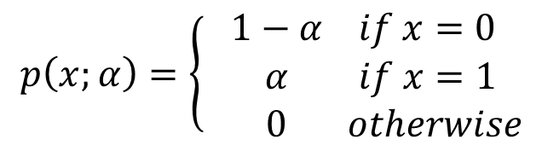
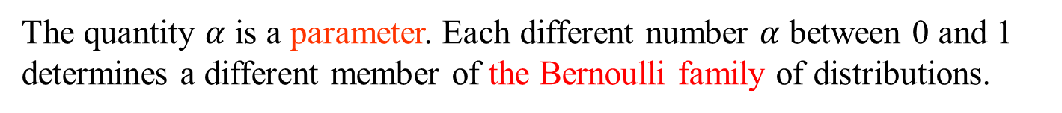
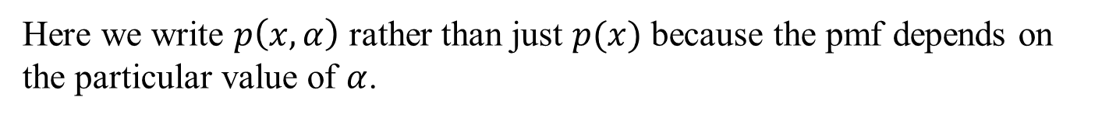
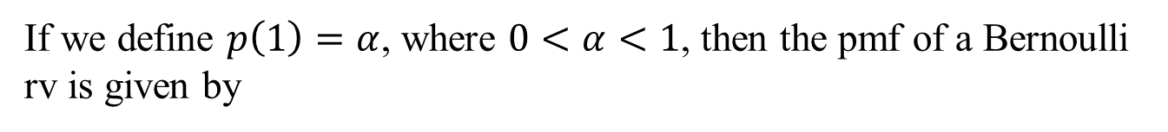
If we define $p\left(1\right)=α$, where $0<α<1$, then the pmf of a Bernoulli rv is given by
$$p\left(x;α\right)=\left\{\begin{aligned}1−α if x=0 \\ α if x=1 \\ 0 otherwise\end{aligned}\right.$$
Here we write $p\left(x,α\right)$ rather than just $p(x)$ because the pmf depends on the particular value of $α$.
The quantity $α$ is a parameter. Each different number $α$ between 0 and 1 determines a different member of the Bernoulli family of distributions.

Slide 12
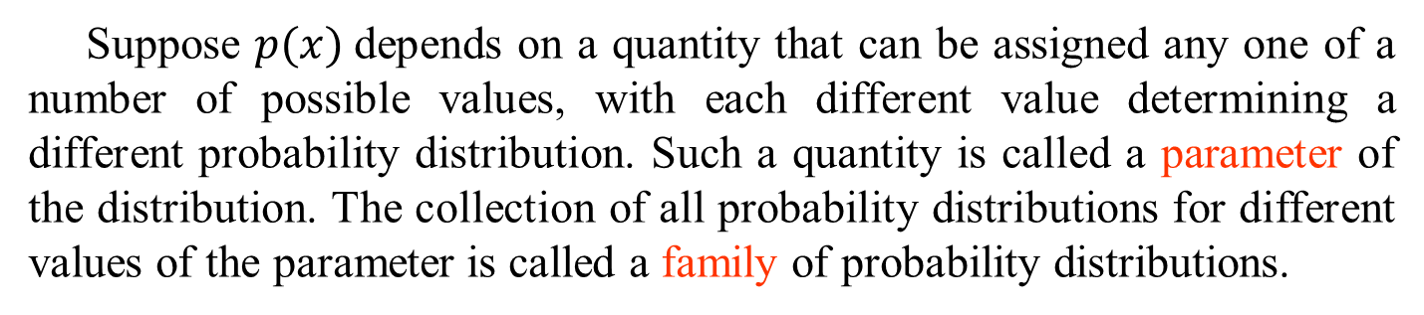
Definition
Suppose $p(x)$depends on a quantity that can be assigned any one of a number of possible values, with each different value determining a different probability distribution. Such a quantity is called a parameter of the distribution. The collection of all probability distributions for different values of the parameter is called a family of probability distributions.

Slide 13





Example
Consider a sequence of independent Bernoulli trials. On each trial, an event $A$ will occur with probability $p$. Let $Y$be the number of trials up to the first $A$ occurring. What is the pmf of $Y$?
$$p\left(1\right)=P\left(Y=1\right)=P\left(A\right)=p$$
$$p\left(2\right)=P\left(Y=2\right)=P\left(A^{′}A\right)=\left(1−p\right)p$$
$$p\left(3\right)=P\left(Y=3\right)=P\left(A^{′}A′A\right)={(1−p)}^{2}p$$
Continuing in this way, a general formula emerges:
$$p\left(x\right)=\left\{\begin{aligned}{(1−p)}^{x−1}p \\ 0\end{aligned}\right.$$
$$x=1,2,3,…$$
otherwise
Each different number $p$ between $0$ and $1$ determines a different member of the geometric family of distributions.

Slide 14



Questions: For the geometric family of distributions
$\sum_{all possible x}^{ }{p(x)}=1$?
$$\sum_{x=1}^{∞}{{(1−p)}^{x−1}p}=p\sum_{m=0}^{∞}{{(1−p)}^{m}=1}$$
Recall that the partial sum of a geometric series is
$\sum_{m=0}^{k}{a^{m}}=\frac{1−a^{k+1}}{1−a}$.

Slide 15







The Cumulative Distribution Function
For some fixed value $x$, we often wish to compute the probability that the observed value of $X$ will be at most $x$.
For example, if the pmf of a rv $X$ is
$$p\left(x\right)=\left\{\begin{aligned}\begin{matrix}0.500 x=0 \\ 0.167 x=1\end{matrix} \\ \begin{matrix}0.333 x=2 \\ 0 otherwise\end{matrix}\end{aligned}\right.$$
The probability that $X$ is at most $0$ is then
For any $x<0$, $P\left(X≤x\right)=0$,
For $x=0, P\left(X≤0\right)=P\left(X=0\right)=0.5$.
and for any $0<x<1$,
$P\left(X≤x\right)=P\left(X≤0\right)=0.5$.

Slide 16











Similarly,
$$P\left(X≤1\right)$$
$$=P\left(X=0\right)+P\left(X=1\right)=0.667$$
For any $1<x<2$,
$P\left(X≤x\right)=P\left(X≤1\right)=0.667$.
$$P\left(X≤2\right)$$
$=P\left(X=0\right)+P\left(X=1\right)+P(X=2)=1$.
For any $x>2$, $P\left(X≤x\right)=P\left(X≤2\right)=1$.
For any real number $x$, define
$F\left(x\right)=P(X≤x)$.
Then
$$F(x)$$
$$F\left(x\right)=\left\{\begin{aligned}\begin{matrix} 0 x<0 \\ 0.500 0≤x<1\end{matrix} \\ \begin{matrix}0.667 1≤x<2 \\ 1 x≥2 \end{matrix}\end{aligned}\right.$$
$$0$$
$$1$$
$$2$$
$$x$$

Slide 17


We find that the graph of $F(x)$ has a jump at every possible value of $X$ and is flat between possible values. Such a function is called a step function.
Definition
The cumulative distribution function (cdf) $F(x)$of a discrete rv $X$ with pmf $p(x)$is defined for every number$x$by
$F\left(x\right)=P\left(X≤x\right)=\sum_{y≤x}{p(y)}$.
For any number $x$, $F(x)$is the probability that the observed value of $X$ will be at most $x$.
Remark
Cdf of a rv $X$ is an increasing function. It increases from $0$ to $1$
For a discrete rv $X$, cdf of $X$ is a step function,

Slide 18


pmf and cdf of a discrete random variable
$$p(x)$$
$$0.5$$
$p\left(x\right)=P\left(X=x\right)$.
$$0$$
$$1$$
$$2$$
$$x$$
$$F(x)$$
$$F\left(x\right)=P\left(X≤x\right).$$
$$0$$
$$1$$
$$2$$
$$x$$

Slide 19




Conclusion: pmf and cdf of a discrete random variable
For $X$, a discrete rv, pmf is the probability mass function defined for every number $x$. It tells the probability that the rv $X$ takes $x$. That is
$p\left(x\right)=P\left(X=x\right)$.
The cdf is the cumulative distribution function defined for every number$x$. It tells the probability that the observed value of $X$ will be at most $x$. That is
$$F\left(x\right)=P\left(X≤x\right).$$
If the pmf is available, then cdf can be derived.
This process can be reversed to obtain the pmf from the cdf whenever the latter function is available.

Slide 20








Example
We again consider a sequence of independent Bernoulli trials. On each trial, an event $A$ will occurs with probability $p$. Let $X$be the number of trials up to the first $A$ occurring. The pmf of $X$ is given by
$$p\left(x\right)=\left\{\begin{aligned}{(1−p)}^{x−1}p \\ 0\end{aligned}\right.$$
$$x=1,2,3,…$$
otherwise
Now we aim to find the cdf of $X$.
For any positive integer $x$,
$$F\left(x\right)=P(X≤x)$$
$=\sum_{y=1}^{x}{p(y)}=\sum_{y=1}^{x}{{(1−p)}^{y−1}p}$
$=p\sum_{m=0}^{x−1}{{(1−p)}^{m}}$

Slide 21



Then for any positive integer $x$,
$F(x)=p\sum_{m=0}^{x−1}{{(1−p)}^{m}}=p\frac{1−{(1−p)}^{x}}{p}={1−(1−p)}^{x}$ .
Since $F$ is constant between two positive integers,
$$F\left(x\right)=\left\{\begin{aligned} 0, x<1 \\ 1−{\left(1−p\right)}^{\left[x\right]},x≥1\end{aligned}\right.$$
where $[x]$is the largest integer less than $x$, (rounding function).

Slide 22






If the cdf is available, then the probability of interest can be derived.
Proposition
For any two numbers $a$ and $b$ with $a≤b$,
$P\left(a≤X≤b\right)=F\left(b\right)−F(a−)$,
where “$a−$ ” represents the largest possible $X$ value that is strictly less than $a$.
In particular, if the possible values are integers and if $a$ and $b$ are integers, then
$$P\left(a≤X≤b\right)=P\left(X=a or a+1 or…or b\right)$$
$$=F\left(b\right)−F\left(a−1\right).$$
If $a$is a possible value, $p\left(a\right)=P\left(X=a\right)=F\left(a\right)−F\left(a−\right).$

Slide 23


pmf and cdf of a discrete random variable
$$p(x)$$
$$0.5$$
$p\left(x\right)=P\left(X=x\right)$.
$$0$$
$$1$$
$$2$$
$$x$$
$$F(x)$$
$$F\left(x\right)=P\left(X≤x\right).$$
$$0$$
$$1$$
$$2$$
$$x$$

Slide 24



3.3 Expected value of Discrete Random Variables
Let’s begin from a typical example.
Consider a university having $15,000$ students and let $X=$ the number of courses for which a randomly selected student is registered. The pmf of $X$ follows.
$$x$$ | $$1$$ | $$2$$ | $$3$$ | $$4$$ | $$5$$ | $$6$$ | $$7$$
$$p(x)$$ | $$0.01$$ | $$0.03$$ | $$0.13$$ | $$0.25$$ | $$0.39$$ | $$0.17$$ | $$0.02$$
No. registered | $$150$$ | $$450$$ | $$1950$$ | $$3750$$ | $$5850$$ | $$2550$$ | $$300$$
Since $p\left(1\right)=0.01$, we know that $0.01\left(15000\right)=150$of the students are registered for one course, and similarly for the other $x$ values.
What is the average number of courses per student?

Slide 25



Is it the ordinary average of 1, . . . , 7, which is $\frac{1+…+7}{7}=4$?
No! Because more students register for $4, 5$ and $6$ courses than for other number of courses.
Instead we compute the total number of courses taken by all students and divide it by the total number of students:
$$\frac{1\left(150\right)+2\left(450\right)+3\left(1950\right)+4\left(3750\right)+5\left(5850\right)+6\left(2550\right)+7(300)}{15000}$$
$=1∙p\left(1\right)+2∙p\left(2\right)+…+7∙p\left(7\right)=4.75$.
We find that the average number of courses per student, or equivalently the average or mean value of $X$, is a weighted average of the possible values $1, . . . , 7,$where the weights are the probabilities of those values.

Slide 26




The Expected Value of $X$
Definition
Let $X$ be a discrete rv with set of possible values $D$ and pmf $p(x).$The expected value or mean value of $X$, denoted by $E(X)$or $μ_{X}$ or just $μ$ is
$E\left(X\right)=μ_{X}=\sum_{x∈D}{x∙p(x)}$.
Let’s go back to the typical example at the beginning.
Let $X=$ the number of courses for which a randomly selected student from a university is registered. If the pmf of $X$ is given, then we can calculate $E(X)$ as follows.
$E(X)=1∙p\left(1\right)+2∙p\left(2\right)+…+7∙p\left(7\right)=4.75$.

Slide 27



How to interpret the expected value of $X$
If we think of the population as consisting of all the possible $X$ values $x_{1}, x_{2},…$in proportion $p\left(x_{1}\right), p\left(x_{2}\right),…$ respectively, then $E(X)$ or $μ$ is the population mean.
Since $E(X)$ is the weighted average of all the possible $X$ values, it may not be a possible value of the rv $X$.

Slide 28




Example
Let $X$ be a Bernoulli rv with pmf $p\left(1\right)=p$ and $p\left(0\right)=1−p$.
What is $E(X)$?
Solution
$E\left(X\right)=1∙p+0∙\left(1−p\right)=p$.
If we repeatedly perform Bernoulli experiments a large number of times, then we have a population consisting $1$s and $0$s in proportion $p$ and $1−p$ respectively and the population average is $E\left(X\right)=p$.
Obviously, $E\left(X\right)$can be also interpreted as the long-run average observed value of $X$.

Slide 29








Example
Let $X$ be a geometric rv with pmf
$$p\left(x\right)=\left\{\begin{aligned}{(1−p)}^{x−1}p \\ 0\end{aligned}\right.$$
$$x=1,2,3,…$$
otherwise
Please calculate $E(X)$?
Solution
$E\left(X\right)=\sum_{x=1}^{∞}{x∙p(x)}=\sum_{x=1}^{∞}{x{(1−p)}^{x−1}p }$
$=−p\sum_{x=1}^{∞}{\frac{d}{dp}}{(1−p)}^{x}$
$=−p\frac{d}{dp}\sum_{x=1}^{∞}{{(1−p)}^{x}}$
$=−p{\left(\frac{1−p}{p}\right)}^{′}$
$=\frac{1}{p}$

Slide 30


We consider a sequence of independent Bernoulli trials. On each trial, an event $A$ will occur with probability $p$. Let $X$be the number of trials up to the first $A$ occurring. Then $X$ is a geometric rv and $E\left(X\right)=\frac{1}{p}$.
Intuitively, if $p$ is near $1$, we expect to see $A$ occurs very soon, whereas if $p$ is near $0$, we may expect many trials before the first $A$ occurring.

Slide 31







Example
Let $X$, the number of interviews a student has prior to getting a job, have pmf
$p\left(x\right)=\left\{\begin{aligned} \frac{k}{x^{2}} \\ 0\end{aligned}\right.$
$$x=1,2,3,…$$
otherwise
where $k$ is chosen so that $\sum_{x=1}^{∞}{\frac{k}{x^{2}}=1}$.
$\left(\sum_{x=1}^{∞}{\frac{1}{x^{2}} }=\frac{π^{2}}{6}\right)$
$E\left(X\right)=\sum_{x=1}^{∞}{x∙\frac{k}{x^{2}}=k\sum_{x=1}^{∞}{\frac{1}{x}}}$
$$=∞$$
$E(X)$is not finite here because $p(x)$does not decrease sufficiently fast as $x$ increases; statisticians say that the probability distribution of $X$ has “a heavy tail.”

Slide 32



The Expected Value of Functions of rv
Sometimes interest will focus on the expected value of some function $h(X)$rather than on just $E(X).$
Example
Suppose a bookstore purchases ten copies of a book at $$6.00$ each to sell at $$12.00$with the understanding that at the end of a $3$-month period any unsold copies can be redeemed for $$2.00$. If $X=$ the number of copies sold, then net revenue $=$
$h\left(X\right)=12X+2\left(10−X\right)−60=10X−40$. Suppose the pmf of $X$ is given as follows.
$$x$$ | $$5$$ | $$6$$ | $$7$$ | $$8$$ | $$9$$ | $$10$$
$$p(x)$$ | $$0.2$$ | $$0.25$$ | $$0.2$$ | $$0.15$$ | $$0.1$$ | $$0.1$$
What then is the expected net revenue?

Slide 33





Solution
Since $X$ is a random variable, so is $Y=h\left(X\right)=10X−40$. The pmf of $Y$ can be derived from the pmf of $X$ as follows.
$$y=h(x)$$ | $$10$$ | $$20$$ | $$30$$ | $$40$$ | $$50$$ | $$60$$
$$p(y)$$ | $$0.2$$ | $$0.25$$ | $$0.2$$ | $$0.15$$ | $$0.1$$ | $$0.1$$
Let $D$ and $D^{∗}$ be the set of possible values of $X$ and $Y$ respectively.
$E\left(Y\right)=\sum_{y∈D^{∗}}{y∙p(y)}$
$$=10\left(0.2\right)+20\left(0.25\right)+30\left(0.2\right)+40\left(0.15\right)+50\left(0.1\right)+60(0.1)$$
$$=h\left(5\right)\left(0.2\right)+h\left(6\right)\left(0.25\right)+h\left(7\right)\left(0.2\right)+h\left(8\right)\left(0.15\right)+h\left(9\right)\left(0.1\right)+h(10)(0.1)$$
$=\sum_{x∈D}{h(x)∙p(x)}$
We find that it was not necessary to determine the pmf of $Y$ in order to obtain $E\left(Y\right)!$

Slide 34



Proposition
If the rv $X$ has a set of possible values $D$ and pmf $p(x)$, then the expected value of any function $h(X),$denoted by $E(h\left(X\right))$or $μ_{h(X)}$, is computed by
$E\left(h\left(X\right)\right)=\sum_{x∈D}{h(x)∙p(x)}$.
That is, $E(h(X))$is computed in the same way that $E(X)$itself is, except that $h(x)$is substituted in place of $x$.

Slide 35





Example
The cost of a certain vehicle diagnostic test depends on the number of cylinders $X$ in the vehicle’s engine. Suppose the cost function is given by $h\left(X\right)=20+3X+0.5X^{2}$ and the pmfs of $X$ are as follows:
$$x$$ | $$4$$ | $$6$$ | $$8$$
$$p(x)$$ | $$0.5$$ | $$0.3$$ | $$0.2$$
What is $E(h(X))$?
Solution
$$E\left(h\left(X\right)\right)=h\left(4\right)\left(0.5\right)+h\left(6\right)\left(0.3\right)+h(8)(0.2)$$
$$=40\left(0.5\right)+56\left(0.3\right)+76(0.2)$$
$$=52$$

Slide 36




Rules of Expected Value
The $h(X)$function of interest is quite frequently a linear function $aX+b$. In this case, $E[h(X)]$is easily computed from $E(X).$
Proposition
$E\left(aX+b\right)=aE\left(X\right)+b$, where both $a$ and $b$ are constants
Proof.
$E\left(aX+b\right)=\sum_{x∈D}{(ax+b)∙p(x)}$
$=a\sum_{x∈D}{x∙p(x)}+b\sum_{x∈D}{p(x)}$
$$=aE\left(X\right)+b$$

Slide 37



The Variance of $X$
If we think of the population as consisting of all the possible $X$ values $x_{1}, x_{2},…$in proportion $p\left(x_{1}\right), p\left(x_{2}\right),…$ respectively.
We can compute the population mean, which is $E(X)$ or $μ$.
You might ask "how are the values spread out?”
This suggests finding the expectation of the random variable $X−μ$ because it is the rv describing the distance from the expected value.
Unfortunately, $E\left(X−μ\right)=E\left(X\right)−μ=0$.

Slide 38






We could imagine taking the absolute value, but it turns out to have nicer properties if we square it instead. This gives the definition of variance:
Let $X$ have pmf $p(x)$and expected value $μ$. Then the variance of$X$, denoted by $V(X)$ or $σ_{X}^{2}$ or just $σ^{2}$ is
$$V\left(X\right)=E\left({\left(X−μ\right)}^{2}\right)$$
$=\sum_{x∈D}{{(x−μ)}^{2}∙p(x)}$ .
The standard deviation (SD) of $X$ is
$σ_{X}=\sqrt{V(X)}$.
If most of the probability distribution is close to $μ$, then $σ^{2}$ will be relatively small. However, if there are $X$ values far from $μ$ that have large $p(x),$then $σ^{2}$ will be quite large.
Variance is a measure of how spread out a distribution is.

Slide 39







A Shortcut Formula for $σ^{2}$
Proposition
$V\left(X\right)=σ^{2}=E\left(X^{2}\right)−{(E(X))}^{2}$.
Proof.
$V\left(X\right)=\sum_{x∈D}{{(x−μ)}^{2}∙p(x)}$
$=\sum_{x∈D}{(x^{2}−2μx+μ^{2})∙p(x)}$
$=\sum_{x∈D}{x^{2}∙p(x)}−2μ\sum_{x∈D}{x∙p\left(x\right)}+μ^{2}$ $\sum_{x∈D}{p(x)}$
$$=E\left(X^{2}\right)−2{\left(E\left(X\right)\right)}^{2}+{(E\left(X\right))}^{2}$$
$$=E\left(X^{2}\right)−{(E(X))}^{2}$$

Slide 40




Example
Let $X$ be a Bernoulli rv with pmf $p\left(1\right)=p$ and $p\left(0\right)=1−p$.
What is $V(X)$?
Solution
$E\left(X\right)=1∙p+0∙\left(1−p\right)=p$.
$E$($X^{2}$)$=1∙p+0∙\left(1−p\right)=p$.
$V\left(X\right)=p−p^{2}=p(1−p)$.
$σ_{X}=\sqrt{V(X)}=\sqrt{p(1−p)}$.

Slide 41





Rules of Variance
Question:
Suppose the rv $X$ have a set of possible values $D$ and pmf $p(x)$. What is the variance of $h(X)$?
The variance of $h(X)$is the expected value of the squared difference between $h\left(X\right)$ and its expected value:
$$V\left[h\left(X\right)\right]=σ_{h(X)}^{2}$$
$=\sum_{D}{{(h\left(x\right)−E[h(X)])}^{2}∙p(x)}$
By the Shortcut Formula
$$V\left[h\left(X\right)\right]=E[h{\left(X\right)}^{2}]−{E[h\left(X\right)]}^{2}\text{.}$$

Slide 42



If $h\left(X\right)=aX+b$, where both $a$ and $b$ are constants, then
$E\left(h\left(X\right)\right)=aE\left(X\right)+b$.
Question: $V\left[h\left(X\right)\right]=?$
$$h\left(X\right)−E\left[h\left(X\right)\right]=aX+b−aE\left(X\right)−b=a\left(X−E\left(X\right)\right).$$
Thus $V\left[h\left(X\right)\right]=E\left[{\left(h\left(X\right)−E\left[h\left(X\right)\right]\right)}^{2}\right]=a^{2}E[{\left(X−E\left(X\right)\right)}^{2}]$
$=a^{2}V(X)$
$V\left[aX+b\right]=σ_{aX+b}^{2}=a^{2}V(X)$ and $σ_{aX+b}=|a|σ_{X}$.
Conclusion:

Slide 43




Example
The cost of a certain vehicle test depends on the number of cylinders $X$ in the vehicle’s engine. Suppose the cost function is given by $h\left(X\right)=20+3X+0.5X^{2}$ and the pmf of $X$ are as follows:
$$x$$ | $$4$$ | $$6$$ | $$8$$
$$p(x)$$ | $$0.5$$ | $$0.3$$ | $$0.2$$
We have obtained that $E\left[h\left(X\right)\right]=52$. What is $V[h\left(X\right)]$?
Solution
$$V[h(X)]=E[h{\left(X\right)}^{2}]−{E[h\left(X\right)]}^{2}$$
$$=h{\left(4\right)}^{2}\left(0.5\right)+h{\left(6\right)}^{2}\left(0.3\right)+h{\left(8\right)}^{2}\left(0.2\right)−{52}^{2}$$
$$={40}^{2}\left(0.5\right)+{3136}^{2}\left(0.3\right)+{76}^{2}\left(0.2\right)−{52}^{2}$$
$$=192$$

Slide 44





Review
The Expected Value of $X$
Let $X$ be a discrete rv with set of possible values $D$ and pmf $p(x).$The expected value or mean value of $X$, denoted by $E(X)$or $μ_{X}$ or just $μ$ is
$E\left(X\right)=μ_{X}=\sum_{x∈D}{x∙p(x)}$.
The Expected Value of a Function
The expected value of any function $h(X),$denoted by $E(h\left(X\right))$or $μ_{h(X)}$, is computed by
$E\left(h\left(X\right)\right)=\sum_{x∈D}{h(x)∙p(x)}$.
Rules of Expected Value
$E\left(aX+b\right)=aE\left(X\right)+b$, where both $a$ and $b$ are constants

Slide 45









The Variance of $X$
Let $X$ have pmf $p(x)$and expected value $μ$. Then the variance of$X$, denoted by $V(X)$ or $σ_{X}^{2}$ or just $σ^{2}$ is
$$V\left(X\right)=E({(X−μ)}^{2})$$
The standard deviation (SD) of $X$ is
$σ_{X}=\sqrt{V(X)}$.
A Shortcut Formula for $σ^{2}$
$V\left(X\right)=σ^{2}=E\left(X^{2}\right)−{E(X)}^{2}$.
Moreover
$$V\left[h\left(X\right)\right]=σ_{h(X)}^{2}$$
$=\sum_{D}{{(h\left(x\right)−E[h(X)])}^{2}∙p(x)}$
$V\left[aX+b\right]=σ_{aX+b}^{2}=a^{2}V(X)$ and $σ_{aX+b}=|a|σ_{X}$.

Slide 46

The moments (矩) of rv
Definition: Denote X as the random variable, c is a constant, k is a positive integer, then
1) E[(X－c)^{k}] is the kth population moment;
2) If c＝0, a_{k}=E(X^{k}) is the kth origin moment;
3) If c=E(X), μ_{k}=E[(X－E[X])^{k}] is kth central moment.
From the definition, we know that: E(X) is the first order origin moment, D(X) is the second order central moment.
1 Skewness (偏度) coefficient: $\frac{μ_{3}}{μ_{2}^{\frac{3}{2}}}=\frac{E[(X−E[X])^{3}]}{(Var[X])^{3/2}};$
2 Kurtosis (峰度) coefficient: $\frac{μ_{4}}{μ_{2}^{2}}=\frac{E[(X−E[X])^{4}]}{(Var[X])^{2}}$.

Slide 47


3.4 The Binomial Probability Distribution (二项分布)
Consider an experiment consisting of a sequence of $n$ independent smaller experiment called trials. Each trial is assumed to have only two outcomes, either success or failure. The probability of success is constant from trial to trial, which is denoted by $p$. Such an experiment is called a binomial experiment.
Example
The same coin is tossed successively and independently $n$ times. We use $S$ to denote the outcome $H$(heads) and $F$ to denote the outcome $T$ (tails).
Then this experiment is a binomial experiment

Slide 48

Remark
Many experiments involve a sequence of independent trials for which there are more than two possible outcomes on any one trial. A binomial experiment can then be created by dividing the possible outcomes into two groups.
Example
The same dice is rolling successively and independently $n$ times. For every rolling there are 6 possible outcomes. But we use $S$ to denote the event that an even number appears and $F$ to denote the event that an odd number appears.
Then this experiment is also a binomial experiment

Slide 49





The Binomial Random Variable and Distribution
The binomial random variable $X$ associated with a binomial experiment consisting of $n$ trials is defined as
$X=$the number of $S$’s among the $n$ trials.
We will often write $X\sim Bin(n,p)$ to indicate that $X$ is a binomial rv based on $n$ trials with success probability $p$.
The possible values of $X$ are $0,1,2,…,n$, and thus $X$ is a discrete random variable. If $X$’s pmf is available, then we can calculate any probability of interest.
Because the pmf of a binomial rv $X$ depends on the two parameters $n$ and $p$, we denote the pmf by $b(x;n, p).$

Slide 50










In the following, we aim to derive the pmf $b(x;n, p)$.
Consider the case $n=4$. Then
$$b\left(0;4, p\right)=P\left(X=0\right)=P(FFFF)$$
$$=P{\left(F\right)}^{4}={\left(1−p\right)}^{4}$$
$$b\left(1;4, p\right)=P\left(X=1\right)=P(SFFF∪FSFF∪FFSF∪FFFS)$$
$$=4∙p{\left(1−p\right)}^{3}$$
$=\left({4 \atop 1}\right)p{\left(1−p\right)}^{3}$
$$b\left(2;4, p\right)=P\left(X=2\right)$$
$=\left({4 \atop 2}\right)p^{2}{\left(1−p\right)}^{2}$
$$b\left(3;4, p\right)=P\left(X=3\right)$$
$=\left({4 \atop 3}\right)p^{3}{\left(1−p\right)}^{1}$
$$b\left(4;4, p\right)=P\left(X=4\right)$$
$=p^{4}=\left({4 \atop 4}\right)p^{4}{\left(1−p\right)}^{0}$

Slide 51




Theorem
If $X\sim Bin(n,p)$, then it has pmf
$$b\left(x;n,p\right)=\left\{\begin{aligned}\left({n \atop x}\right)p^{x}{\left(1−p\right)}^{n−x}, x=0,1,2,…,n \\ 0, otherwise\end{aligned}.\right.$$
Substituting $\left({n \atop x}\right)=\frac{n!}{\left(n−x\right)!x!}$ into the above expression, we find that
$b\left(x;n,p\right)=\frac{n!}{\left(n−x\right)!x!}p^{x}{\left(1−p\right)}^{n−x},$ $x=0,1,2,…,n$
By binomial theorem
$\sum_{x=0}^{n}{\left({n \atop x}\right)p^{x}{\left(1−p\right)}^{n−x}}={\left[p+\left(1−p\right)\right]}^{n}=1$.

Slide 52




Example
Each of six randomly selected cola drinkers is given a glass containing cola $S$ and one containing cola $F$. The glasses are identical in appearance except for a code on the bottom to identify the cola. Suppose $p=P$(a selected individual prefers $S$) $=0.5$. So with $X=$ the number among the six who prefer $S$, $X\sim Bin(6, 0.5)$.
Thus
$$P(X=3)$$
$=b\left(3;6,0.5\right)=\left({6 \atop 3}\right){0.5}^{3}{\left(1−0.5\right)}^{2}=0.313$
The probability that at least three prefer $S$ is
$$P\left(X≥3\right)=$$
$\sum_{x=3}^{6}{\left({6 \atop x}\right){0.5}^{x}{\left(1−0.5\right)}^{6−x}}=0.656$.

Slide 53




The cdf of $X$ and Using Binomial Tables
Even for a relatively small value of $n$, the computation of binomial probabilities can be tedious. In fact we can calculate probabilities of interest by lookup the tables showing cdf $F\left(x\right)=P(X≤x)$ for different $n$ in combination with selected values of $p$.
Notation
For $X\sim Bin(n,p)$, the cdf will be denoted by
$B\left(x;n,p\right)=P\left(X≤x\right)=\sum_{y=0}^{x}{b(y;n,p)}$, $x=0,1,2,…,n$.
Other values of $B\left(x;n,p\right)$ can be deduced easily. The next page shows $B(x;n,p)$ for $n=15$.

Slide 54

Why does not the table give the value of $b(n;n,p)$?

Slide 55






Example
Suppose that $20\%$of all copies of a particular textbook fail a certain binding strength test. Let $X$ denote the number among $15$ randomly selected copies that fail the test. Then $X$ has a binomial distribution with and $n=15$ and $p=0.2$.
1. The probability that at most $8$ fail the test is
$$P\left(X≤8\right)=B(8;15,0.2)$$
$$=0.999$$
2. The probability that exactly $8$ fail is
$$P\left(X=8\right)=P\left(X≤8\right)−P\left(X≤7\right)=B\left(8;15,0.2\right)−B(7;15,0.2)$$
$$=0.003$$
3. The probability that at least $8$ fail is
$$P\left(X≥8\right)=1−P\left(X≤7\right)=1−B\left(7;15,0.2\right)=1−0.996=0.004.$$
4. Finally, the probability that between $4$ and $7$, inclusive, fail is
$P\left(4≤X≤7\right)=P\left(X≤7\right)−P\left(X≤3\right)=0.996−0.648=0.348$.

Slide 56








The Mean and Variance of $X$
Proposition
If $X\sim Bin(n,p)$, then
$E\left(X\right)=np, V\left(X\right)=np(1−p)$.
Proof.
$E\left(X\right)=\sum_{x=0}^{n}{x∙\left({n \atop x}\right)p^{x}{\left(1−p\right)}^{n−x}}$
$=\sum_{x=1}^{n}{\frac{n!}{\left(n−x\right)!(x−1)!}p^{x}{\left(1−p\right)}^{n−x}}$
$=np\sum_{k=0}^{n−1}{\frac{(n−1)!}{\left(n−1−k\right)!k!}p^{k}{\left(1−p\right)}^{n−1−k}}$
$$=np{\left(p+1−p\right)}^{n−1}=np$$
The expected number of success among $n$ independent trials is the product of $n$ and the probability of success on a single trial.

Slide 57








$E\left(X^{2}\right)=\sum_{x=0}^{n}{x^{2}∙\left({n \atop x}\right)p^{x}{\left(1−p\right)}^{n−x}}$
$=\sum_{x=1}^{n}{\frac{n!x}{\left(n−x\right)!(x−1)!}p^{x}{\left(1−p\right)}^{n−x}}$
$=np\sum_{k=0}^{n−1}{\frac{\left(n−1\right)!(k+1)}{\left(n−1−k\right)!k!}p^{k}{\left(1−p\right)}^{n−1−k}}$
$=np\sum_{k=0}^{n−1}{(k+1)\left({n−1 \atop k}\right)p^{k}{\left(1−p\right)}^{n−1−k}}$
$=np\left[\sum_{k=0}^{n−1}{k\left({n−1 \atop k}\right)p^{k}{\left(1−p\right)}^{n−1−k}+\sum_{k=0}^{n−1}{\left({n−1 \atop k}\right)p^{k}{\left(1−p\right)}^{n−1−k}}}\right]$
$$=np\left[\left(n−1\right)p+1\right]$$
$$=n^{2}p^{2}+np(1−p)$$
$V\left(X\right)=E\left(X^{2}\right)−E{\left(X\right)}^{2}=np(1−p)$.

Slide 58




The Binomial rv and Bernoulli rv
Consider a Binomial experiment consisting of a sequence of $n$ independent trials. Each trial has only two outcomes, either success or failure. The probability of success is constant from trial to trial, which is denoted by $p$.
$$X_{i}=\left\{\begin{aligned}1, \\ 0,\end{aligned}\right.$$
if the outcome of ith trial is success
Let
otherwise
Then each $X_{i}$ is a Bernoulli rv.
$E\left(X_{i}\right)=p$ and $V\left(X_{i}\right)=p(1−p)$.

Slide 59



Let $X=$the number of $S$’s among the $n$ trials.
Then $X$ is a Binomial rv and $X=X_{1}+X_{2}+…+X_{n}$.
Thus a Binomial rv with $n$ trials can be viewed as a sum of $n$ independent Bernoulli rv’s.
By the linearity of expectation
$E\left(X\right)=E\left(X_{i}\right)+E\left(X_{2}\right)+…+E\left(X_{n}\right)=np$.
Since $X_{1}, X_{2},…,X_{n}$ are independent, we will find in Chapter $5$ that
$$V\left(X\right)=V\left(X_{1}\right)+…+V\left(X_{n}\right)=np\left(1−p\right).$$

Slide 60





Example
If $75\%$of all purchases at a certain store are made with a credit card and $X$ is the number among ten randomly selected purchases made with a credit card, then what is the probability that $X$ is within $1$ standard deviation of its mean value?
Solution
$X\sim Bin(10,0.75)$.
$$E\left(X\right)=10×0.75=7.5,$$
$V\left(X\right)=10×0.75×0.25=1.875$ and
$σ=\sqrt{1.875}=1.37$.
The desired probability is
$$P\left(7.5−1.375≤X≤7.5+1.375\right)=P\left(6.13≤X≤8.87\right)$$
$=P\left(X=7 or X=8\right)=0.532$.

Slide 61





Example
A box contains 50 balls, of which 40 are red and $X$ is the number of red among ten randomly selected balls. Is$X$ a binomial rv?
No!
Solution
The experiment consist of 10 trials. Each trial is randomly selecting a ball from the box without replacement.
Label the ith trial as a success if the ith ball selected is red.
$P$($S$ on 1)$=\frac{4}{5}=0.8$,
$P$($S$ on $2$)$=P\left(SS\right)+P\left(FS\right)=\frac{4}{5}∙\frac{39}{49}+\frac{1}{5}∙\frac{40}{49}=0.8$, However
$P$($S$on $2$|$S \text{on} 1)=\frac{39}{49}=0.796$,
$P$($S$on $2$|$F \text{on} 1)=\frac{40}{49}=0.816$,
The experiment is not binomial because the trials are not independent. So $X$ is not a binomial rv.

Slide 62





In general, if sampling is without replacement, the experiment will not yield independent trials.
Example A certain state has $500,000$ licensed drivers, of whom $400,000$ are insured and $X$ is the number among ten randomly selected drivers insured. What is the pmf of $X$?
The experiment consist of 10 trials. Each trial is randomly selecting a driver. Label the ith trial as a success if the ith driver selected is insured.
$P$($S$on $2$|$S \text{on} 1)=\frac{399999}{499999}≈0.8000$,
$P$($S$on $2$|$F \text{on} 1)=\frac{400000}{499999}≈0.8000$,
$P$($S$on $10$|$S \text{first} 9)=\frac{399991}{499991}≈0.8000$,
We find that the conditional probabilities differ so slightly from one another that for practical purposes the trials can be regarded as independent with constant $P\left(S\right)=0.8$.

Slide 63

We will use the following rule in deciding whether a “without replacement” experiment can be treated as a binomial experiment.
Rule
Consider sampling without replacement from a population of size $N$. If the sample size (number of trials) $n$ is at most 5% of the population size, the experiment can be analyzed as though it were exactly a binomial experiment.
Question
If sampling is without replacement and the population size is not so big, then what is the probability distribution for the number of successes among the samples?

Slide 64



3.5 (1) The Hypergeometric Distribution
Suppose a population or set consists of $N$ individuals, which can be characterized as a success ($S$) or a failure ($F$), and there are $M$ successes.
The experiment is selecting $n$ individuals without replacement in such a way that each subset of size $n$ is equally likely to be chosen.
Let $X=$ the number of $S$’s in the sample. $X$ is a hypergeometric rv.
The probability distribution of $X$ is the Hypergeometric distribution, which depends on the parameters $n, M$, and $N$, so we wish to obtain $P\left(X=x\right)=h(x;n,M,N)$.

Slide 65






Example A.1 Suppose a box contains $50$balls, of which$40$are red and $X$ is the number of red among $10$ randomly selected balls. Find the pmf of$X$?
Solution
The possible values of $X$ are $0,1,2,…,10$
Because the experiment is randomly selecting $10$ balls from $50$, the sample space contains $\left({50 \atop 10}\right)$ outcomes which are equally likely.
For any possible $x$,
$$P\left(X=x\right)=\frac{number of outcomes having X=x}{\left({50 \atop 10}\right)}$$
$$=\frac{\left({40 \atop x}\right)\left({10 \atop 10−x}\right)}{\left({50 \atop 10}\right)}$$
Note that there are $\left({40 \atop x}\right)$ ways of selecting $x$ red ball, and for each such way there are $\left({10 \atop 10−x}\right)$ ways of selecting the other $10−x$ to fill out the sample.

Slide 66


Example A.2
Suppose a box contains $50$balls, of which$8$are red and $X$ is the number of red among $10$ randomly selected balls. Find the pmf of$X$?
Solution
The possible values of $X$ are $0,1,2,…,7, 8=min⁡\{10,8\}$.
For any possible $x$,
$$P\left(X=x\right)=\frac{number of outcomes having X=x}{\left({50 \atop 10}\right)}$$
$=\frac{\left({8 \atop x}\right)\left({42 \atop 10−x}\right)}{\left({50 \atop 10}\right)}$.

Slide 67




Example A.3
Suppose a box contains $50$balls, of which$42$are red and $X$ is the number of red among $10$ randomly selected balls. Find the pmf of$X$?
Solution
The possible values of $X$ are $2=10−(50−42),3,…,10$.
For any possible $x$,
$$P\left(X=x\right)=\frac{number of outcomes having X=x}{\left({50 \atop 10}\right)}$$
$=\frac{\left({42 \atop x}\right)\left({8 \atop 10−x}\right)}{\left({50 \atop 10}\right)}$.

Slide 68




Proposition
If $X$is the number of $S$’s in a completely random sample of size $n$ drawn from a population consisting of $M$ $S$’s and $N−M F$’s, then the probability distribution of $X$, called the hypergeometric distribution, is given by
$$h\left(x;n,M,N\right)=\frac{\left({M \atop x}\right)\left({N−M \atop n−x}\right)}{\left({N \atop n}\right)}$$
for $x$, an integer, satisfying $max⁡\{0,n−(N−M)\}≤x≤min⁡\{n,M\}$.
Consider the most common case $n≤M$ and $n≤N−M$.
From Vandermonde identity
$\left({N \atop n}\right)=\sum_{x=0}^{n}{\left({M \atop x}\right)\left({N−M \atop n−x}\right)},$
we find that $\sum_{x=0}^{n}{h\left(x;n,M,N\right)}=1$.
It is not hard to find the corresponding result for other cases.

Slide 69




The Mean and Variance of $X$
Proposition
The mean and variance of the hypergeometric rv $X$ having pmf $h(x; n, M, N)$ are then
$E\left(X\right)=n\frac{M}{N}, V\left(X\right)=\frac{N−n}{N−1}∙n∙\frac{M}{N}∙(1−\frac{M}{N})$.
$E\left(X\right)=\sum_{x=0}^{n}{x∙\frac{\left({M \atop x}\right)\left({N−M \atop n−x}\right)}{\left({N \atop n}\right)}}$
Proof.
$=\sum_{x=1}^{n}{\frac{M\left({M−1 \atop x−1}\right)\left({(N−1)−(M−1) \atop \left(n−1\right)−(x−1)}\right)}{\left({N−1 \atop n−1}\right)\frac{N}{n}}}$
$=n\frac{M}{N}\sum_{k=0}^{n−1}{\frac{\left({M−1 \atop k}\right)\left({N−1−(M−1) \atop n−1−k}\right)}{\left({N−1 \atop n−1}\right)}}$
$$=n\frac{M}{N}$$

Slide 70


Suppose that $\text{n}\text{+}\text{M}≤N, n≤M$
$$E\left(X^{k}\right)=\sum_{i=0}^{n}{i^{k}}\frac{\left({M \atop i}\right)\left({N−M \atop n−i}\right)}{\left({N \atop n}\right)}$$
$$=\frac{nM}{N}\sum_{i=1}^{n}{i^{k−1}\frac{\left({M−1 \atop i−1}\right)\left({N−M \atop n−i}\right)}{\left({N−1 \atop n−1}\right)}}$$
$$=\frac{nM}{N}\sum_{j=0}^{n−1}{{(j+1)}^{k−1}\frac{\left({M−1 \atop j}\right)\left({N−M \atop n−j−1}\right)}{\left({N−1 \atop n−1}\right)},i=j+1}$$
$$=\frac{nM}{N}E\left[{\left(Y+1\right)}^{k−1}\right]$$
where Y is a hypergeometric rv: $Y∼H(n−1,M−1,N−1)$

Slide 71

If k=1, we have $E\left(X\right)=\frac{nM}{N}.$
If k=2, we have $E\left(X^{2}\right)=\frac{nM}{N}E\left(Y+1\right)=\frac{nM}{N}\left(\frac{\left(n−1\right)\left(M−1\right)}{N−1}+1\right).$
Thus $V\left(X\right)=E\left(X^{2}\right)−E{\left(X\right)}^{2}=$ $\left(\frac{N−n}{N−1}\right)⋅n⋅\frac{M}{N}⋅\left(1−\frac{M}{N}\right). ∎$

Slide 72



Remark
a) If the sample size $n$ is at most 5% of the population size $N$, the experiment can be analyzed as though it were exactly a binomial experiment.
b) In this case $p=\frac{M}{N}$, and $X$ is viewed as a binomial rv which implies that $E(X)=np$, $V\left(X\right)=np(1−p)$.
c) We find that the means of the binomial and hypergeometric rv’s are equal, whereas the variances of the two rv’s differ by the factor $\frac{N−n}{N−1}$, which is smaller than $1$ and is approximately $1$when $n$ is small relative to $N$.

Slide 73

d) Let the population size, N, and number of population S’s, M, get large with the ratio M/N approaching p.
e) Then h(x; n, M, N) approaches b(x; n, p); so for n/N small (at most 0.05), the two are approximately equal provided that p is not too near either 0 or 1. This is the rationale (基本原理) for the rule.

Slide 74


3.5 (2) The Negative Binomial Distribution
Consider an experiment consisting of a sequence of independent trials. Each trial can result in either a success (S) or a failure (F). The probability of success is constant from trial to trial .
If the experiment consists of a fix number ($n$) of trials and let $X=$the number of $S$’s among the $n$ trials, then $X$ is a binomial rv.
If the experiment continues (trials are performed) until a total of $r$ successes have been observed, where $r$ is a specified positive integer, and let $X=$the number of failures that precede the $r$th
Success, then $X$ is called a negative binomial rv because, in contrast to the binomial rv, the number of successes is fixed and the number of trials is random.

Slide 75




If $X$ is a negative binomial rv, the possible values of $X$ are $0,1,2,…$
We denote the pmf of $X$by $nb(x;r, p).$
Consider $nb\left(7;3, p\right)=P(X=7)$, the probability that exactly $7$ $F$'s occur before the $3$rd $S$.
In order for this to happen, the $10$th trial must be an $S$ and there must be exactly $2$ $S$'s among the first $9$ trials. Thus
$$nb\left(7;3, p\right)=\left({9 \atop 2}\right)p^{2}{\left(1−p\right)}^{7}∙p=\left({9 \atop 2}\right)p^{3}{\left(1−p\right)}^{7}.$$

Slide 76




Proposition
If $X$ is a negative binomial rv with $r=$ number of $S$’s and $p=P(S)$,
then it has pmf
$$nb\left(x;r,p\right)=\left\{\begin{aligned}\left({x+r−1 \atop r−1}\right)p^{r}{\left(1−p\right)}^{x}, x=0,1,2,…, \\ 0, otherwise\end{aligned}.\right.$$
In the special case $r=1$, $X$ is the number of $F$’s until the first $S$, with
the pmf
$$nb\left(x;1,p\right)=\left\{\begin{aligned}p{\left(1−p\right)}^{x}, x=0,1,2,…, \\ 0, otherwise\end{aligned}.\right.$$
$Y=X+1$ is the number of trials until the first $S$, which is a geometric rv.

Slide 77



Example
A doctor wishes to recruit $5$ couples, each of whom is expecting their first child, to participate in a new natural childbirth regimen. Let $p=P($a randomly selected couple agrees to participate). If
$p=0.2$, what is the probability that $15$ couples must be asked before $5$ are found who agree to participate?
That is, with $S=${agree to participate}, what is the probability that $10 F’$s occur before the fifth $S$? Substituting $x=10$, $r=5$ and $p=0.2$ into $nb(x; r, p)$gives
$nb\left(10;5,0.2\right)=\left({14 \atop 4}\right){0.2}^{5}{0.8}^{10}=0.034$.
$$nb\left(10;5,0.2\right)=0.2∙b\left(4;14,0.2\right)=0.2∙[B\left(4;14,0.2\right)−B\left(3;14,0.2\right)]$$

Slide 78



Let $X_{i}$ be the number of $F$’s between $\left(i−1\right)th$ and $ith$ $S$’s
and $X$ be the number of $F$’s that precede the $r$th $S$.
Clearly $X=X_{1}+X_{2}+…+X_{r}$.
Recall that $X_{i}+1$ is a geometric rv. We have
$E(X_{i}+1)=\frac{1}{p}$,
$E\left(X_{i}\right)=\frac{1}{p}−1$.
which implies
And thus
$E\left(X\right)=E\left(X_{1}\right)+E\left(X_{2}\right)+…+E\left(X_{r}\right)=r\left(\frac{1}{p}−1\right)=r\frac{1−p}{p}$ .
On the other hand since $V(X_{i})=V(X_{i}+1)$ and $X_{i}, i=1,2…,r$ are independent and then $V\left(X\right)=rV(Y)$, where $Y$ is a geometric rv.

Slide 79











If $Y$ is a geometric rv with pmf
$$p\left(y\right)=\left\{\begin{aligned}{(1−p)}^{y−1}p \\ 0\end{aligned}\right.$$
$$y=1,2,3,…$$
then,
otherwise
$E\left(Y^{2}\right)=\sum_{y=1}^{∞}{y^{2}{\left(1−p\right)}^{y−1}p}$
$=p(1−p)\sum_{y=1}^{∞}{y\left(y−1\right){\left(1−p\right)}^{y−2}}+\sum_{y=1}^{∞}{y{(1−p)}^{y−1}p}$
$=p(1−p)\sum_{y=1}^{∞}{\frac{d^{2}}{dp^{2}}{\left(1−p\right)}^{y}}$
$+\frac{1}{p}$
$=p\left(1−p\right){\left(\frac{1}{p}−1\right)}^{′′}+\frac{1}{p}$
$=2\left(\frac{1}{p^{2}}−\frac{1}{p}\right)+\frac{1}{p}$
$=\frac{2}{p^{2}}−\frac{1}{p}$ .
And thus $V\left(Y\right)=E\left(Y^{2}\right)−E{\left(Y\right)}^{2}=\frac{1}{p^{2}}−\frac{1}{p}=\frac{1−p}{p^{2} }$.
$V\left(X\right)=rV\left(Y\right)=\frac{r(1−p)}{p^{2}}$.

Slide 80


Proposition
If$X$ is a negative binomial rv with pmf $nb\left(x;r,p\right),$then
$E\left(X\right)=r\left(\frac{1}{p}−1\right)$ and
$V\left(X\right)=r\frac{ (1−p)}{p^{2}}$.

Slide 81







3.6 The Poisson Probability Distribution
Definition
A discrete random variable $X$ is said to have a Poisson distribution with parameter $μ (μ>0)$ if the pmf of $X$ is
$$p\left(x;μ\right)=\frac{e^{−μ}∙μ^{x}}{x!}, x=0,1,2,3…$$
The letter $e$ in the pmf represents the base of the natural logarithm system; its numerical value is approximately $2.71828.$
Yes!
Is $p\left(x;μ\right)$ a legitimate pmf?
By Maclaurin series expansion of $e^{μ}$:
$e^{μ}=1+μ+\frac{μ^{2}}{2}+\frac{μ^{3}}{3!}+…=\sum_{x=0}^{∞}{\frac{μ^{x}}{x!}}$, we find that
$\sum_{x=0}^{∞}{p(x;μ)}=\sum_{x=0}^{∞}{\frac{e^{−μ}∙μ^{x}}{x!}}=e^{−μ}\sum_{x=0}^{∞}{\frac{μ^{x}}{x!}}=1$.

Slide 82



Example
Let $X$ denote the number of creatures of a particular type captured in a trap during a given time period. Suppose that $X$has a Poisson distribution with $μ=4.5$.
The probability that a trap contains exactly five creatures is
$P\left(X=5\right)=p\left(5;4.5\right)=\frac{e^{−4.5}×{4.5}^{5}}{5!}=0.1708$.
The probability that a trap has at most five creatures is
$P\left(X≤5\right)=\sum_{x=0}^{5}{\frac{e^{−4.5}×{4.5}^{x}}{x!}}=e^{−4.5}\left[1+4.5+\frac{{4.5}^{2}}{2}+\frac{{4.5}^{3}}{6}+\frac{{4.5}^{4}}{24}+\frac{{4.5}^{5}}{120}\right]$
$$=0.7029$$

Slide 83


The cdf’s $F\left(x\right)=P(X≤x)$ with $μ=0.1,0.2,…,1,2,…,10,15$ and $20$ are given in the appendix of the textbook.

Slide 84











The mean and variance of $X$
If$X$has a Poisson distribution with parameter $μ$, then $E\left(X\right)=μ$, $V\left(X\right)=μ$.
Proof.
$E\left(X\right)=\sum_{x=0}^{∞}{x∙\frac{e^{−μ}∙μ^{x}}{x!}}$
$=\sum_{x=1}^{∞}{\frac{e^{−μ}∙μ^{x}}{(x−1)!}}$
$=μ\sum_{k=0}^{∞}{\frac{e^{−μ}∙μ^{k}}{k!}}$
$$=μ$$
$E\left(X^{2}\right)=\sum_{x=0}^{∞}{x^{2}∙\frac{e^{−μ}∙μ^{x}}{x!}}$
$=μ\sum_{x=1}^{∞}{x∙\frac{e^{−μ}∙μ^{x−1}}{(x−1)!}}$
$=μ\sum_{k=0}^{∞}{(k+1)\frac{e^{−μ}∙μ^{k}}{k!}}$
$=μ\sum_{k=0}^{∞}{k∙\frac{e^{−μ}∙μ^{k}}{k!}}+μ\sum_{k=0}^{∞}{\frac{e^{−μ}∙μ^{k}}{k!}}$
$$=μ^{2}+μ$$
$$V\left(X\right)=E\left(X^{2}\right)−E{\left(X\right)}^{2}=μ^{2}+μ−μ^{2}=μ$$

Slide 85



The parameter in the pmf of a Poisson rv is its expected value.
The standard deviation is $σ_{X}=\sqrt{μ}$.
If $X\sim Bin(n,p)$,
then $E\left(X\right)=np, V\left(X\right)=np(1−p)$.
If $n$ is large and$p$ is very small, we can use the Poisson distribution with parameter $μ=np$ to approximate the binomial distribution.

Slide 86



The Poisson Probability Distribution
Definition
A discrete random variable $X$ is said to have a Poisson distribution with parameter $μ (μ>0)$ if the pmf of $X$ is
$$p\left(x;μ\right)=\frac{e^{−μ}∙μ^{x}}{x!}, x=0,1,2,3…$$
The letter $e$ in the pmf represents the base of the natural logarithm system; its numerical value is approximately $2.71828.$

Slide 87





The Poisson Distribution as a Limit
Proposition Suppose that in the binomial pmf $b(x;n, p_{n})$. We let $n→∞$ and $p_{n}→0$ in such a way that $np_{n}$ approaches a value $μ>0$. Then $b(x;n, p_{n})→p(x;μ)$.
Proof.
Let $μ_{n}=np_{n}$, then $p_{n}=\frac{μ_{n}}{n}$. For any fixed $x$,
$$b\left(x;n, p_{n}\right)=\left({n \atop x}\right)p_{n}^{x}{\left(1−p_{n}\right)}^{n−x}$$
$$=\frac{n(n−1)⋯(n−x+1)}{x!}∙{\left(\frac{μ_{n}}{n}\right)}^{x}∙{\left(1−\frac{μ_{n}}{n}\right)}^{n−x}$$
$$=\frac{(1−\frac{1}{n})⋯(1−\frac{x−1}{n})}{x!}∙μ_{n}^{x}∙{\left(1−\frac{μ_{n}}{n}\right)}^{n−x}$$
$→\frac{e^{−μ}∙μ^{x}}{x!}$ .

Slide 88


According to this proposition, in any binomial experiment in which $n$ is large and $p$ is small, $b(x;n,p)≈p(x;μ)$ , where $μ=np$ .
As a rule, this approximation can safely be applied if $n>50$ and $np<5$ ($n$ is big and $p$ is small ).

Slide 89



Example Suppose the probability that someone will succeed in doing something is $0.01$. If he/she attempts to do it repeatedly for$400$times, what is the probability that he/she will succeed at least once?
Solution
Let $X=$ the number of successes among the $400$ trials.
$X\sim Bin(400, 0.01)$.
$P\left(X≥1\right)=1−P\left(X=0\right)=1−{0.99}^{400}=0.982$.
If we let $μ=400×0.01=4$ and use Poisson to approximate the binomial distribution, then
$P\left(X≥1\right)=1−P\left(X=0\right)=1−\frac{e^{−μ}μ^{0}}{0!}=1−e^{−μ}=0.9817$.
This example also reminds us of the simple truth that as long as there is one percent hope, we should make one hundred percent effort!

Slide 90



The Poisson Process
Sometimes we may be interested in the number of some events occurring in any time interval of length $t$.
These events of interest might be visits to a particular website, email messages sent to a particular address or accidents in an industrial facility.
We can make the following assumptions about the way in which these events occur:
1. There exists a parameter $α$such that for any short time interval of length $Δt$, the probability that exactly one event occurs is $α∙Δt+o(Δt)$.
2. The probability of more than one event occurring during $Δt$ is $o(Δt)$
3. The number of events occurring during the time interval $Δt$ is independent of the number that occur prior to this time interval.

Slide 91




Informally, the assumptions say that for a short time interval of length $Δt$, the probability of a single event occurring is approximately $α∙Δt$ and the probability of no events is approximately $1−α∙Δt$.
And thus the average number of events occurring in a short time interval of length $Δt$ is approximately $αΔt$, where $α$ is the average number per unit time.
Now let $X$ be the number of events during a time interval of length $t$ and $P_{k}\left(t\right)=P(X=k)$.
Proposition
$P_{k}\left(t\right)=\frac{e^{−αt}{\left(αt\right)}^{k}}{k!}$, so that the number of events during a time interval of length $t$ is a Poisson rv with parameter $αt$.

Slide 92




The occurrence of events over time as described is called a Poisson process; the parameter $α$ specifies the rate for the process.
Example
Suppose pulses arrive at a counter at an average rate of six per minute, so that $α=6$. To find the probability that in a $0.5$-min interval at least one pulse is received, note that the number of pulses in such an interval has a Poisson distribution with parameter
$αt=6\left(0.5\right)=3$.
Then with $X=$ the number of pulses received in the $30$-sec interval,
$$P\left(X≥1\right)=1−P\left(X=0\right)=1−\frac{e^{−3}∙3^{0}}{0!}=1−e^{−3}=0.95.$$

Slide 93



Conclusion of Chapter 3
1. A random variable (rv) is any rule that associates a number with each outcome in $𝒮$.
2. A discrete random variable (rv) is one whose possible values either constitute a finite set or else a countable infinite set.
3. For $X$ a discrete rv, we define its pmf (the probability mass function) and cdf (the cumulative distribution function).
4. The expected value of a discrete rv $X$ is a summation of each possible value multiplied by its probability. The variance is the expected value of the square difference between $X$ and its expected value.
5. The common discrete rv’s include Bernoulli rv, Geometric rv, Binomial rv, hypergeometric rv, negative binomial rv, Poisson rv and so on.

